Slide 1


50-BEDDED UPAZILA HEALTH COMPLEX
Chowgacha, Jessore.

Slide 2
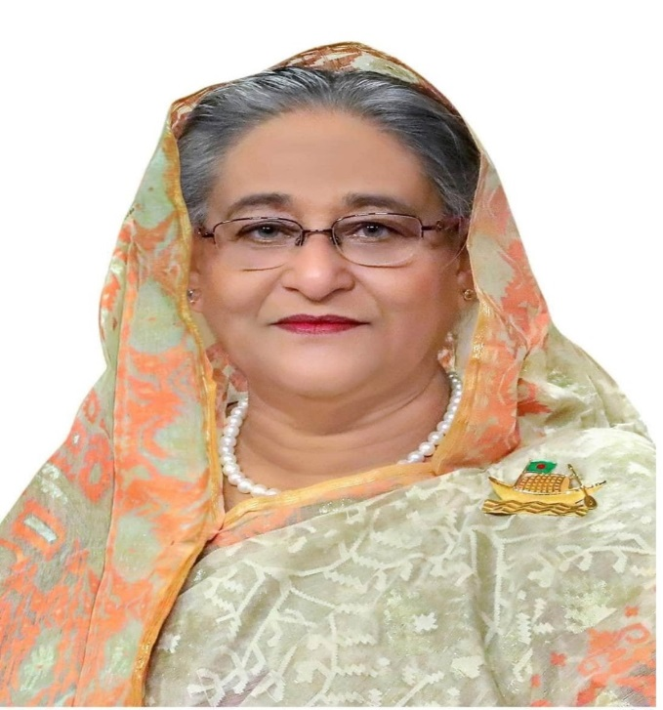
Highest Level Political Commitment
Vision 2021
The government,
especially
the Ministry of Health
and Family Welfare,
is committed to
focus on ensuring
proper safety-net for
the poor, vulnerable,
and marginalized people.
Honourable Prime Minister
Sheikh Hasina
Notes:
2

Slide 3




CHOWGACHA UHC
Old UHC
31-bedded UHC
50-bedded UHC

Slide 4

UHFPO, Upazila Health Complex Chowgacha

Slide 5
A Hospital with a Vision …
Maximum utilization of Govt.
resources with
honesty and sincerity.
Integrated approach of
Administration, Community
Leaders .
Providing Effective services
through improved
management system.

Slide 6
Background History of MCH services of Chowgacha Health Complex, Jessore
To reduce Maternal and Child Mortality and Mobility and to ensure the quality services to the mother and child, UHFPO opened 4 special activities headed by medical officers in Feb. 1996. And from January 1995 to 1997 JICA helped us by Frontline MCH Program to implement the program by giving technical and logistic supports. Since 1998 DGHS & UNICEF have continued the
support.
<4 Special activities>
ANC-Corner
Basic EOC service
Under 5 corner for under 5 children
Monthly birth and death record

Slide 7
Contd.
From Dec. 1999 Reproductive Health Department of DGHS and UNICEF gave logistic supports and human resources development (like medical officer trained in anesthesia).
Form November 2000 started Comprehensive EOC program
In 2004--2014the UHC was awarded by the Bangladesh Government and UNICEF for best performance on EOC Service.
From August 2006 Safe Blood Transfusion unit established with the aid of UNICEF.
From April 2007 Demand Side Financing (DSF) program started.
Women friendly Hospital declared in 2008.
Hospital is declared as model health complex on 20 June 2008 and upgraded to 50 bedded hospital by Secretary of Ministry of Health & family welfare.
Chowgacha health complex Model is replicable through out the country. Declared by Dr. Margaret Chan, D.G. WHO on 8th March 2010.

Slide 8
Characteristics of Chowgacha Health Complex Model-1
Successful leadership in health management
Personal and group skills in health care
Community engaged health management
Optimum use of government resources
Effective relation with local administration and with other government organizations
Improvement of security by community engagement
Improved maternal health care activities
Improved child health care activities
Ensuring corner-based health care
Woman and Baby Friendly Hospital
Display of Protocol Board and Citizen Charter

Slide 9
Characteristics of Chowgacha Health Complex Model-2
Birth and death recording, progress assessment and accountability by collecting information on all health indicators
Improving healthcare by unit management
Health awareness by health education in outdoor, indoor, ante-natal registration room and pregnant women restroom
Cleanliness (Waste management) and beautification of the facility and premises
Provision of safe blood transfusion for emergency needs
Zero tolerance against corruption
Implementation of the 5S KAIZEN-TQM for the improvement of health care
Improved financial management by establishing cash counter

Slide 10
HEALTH PROFILE OF UHC CHOWGACHA 2020
Total Population | 2,63,162
Male Female | 1,32,080 1,31,082
Total Fertile Couple | 53819
Total Pregnant | 4977
Total Delivery | 4525
Total Live Birth | 4503
Total Death | 1008
Total Maternal Death | 01

Slide 11
HEALTH INSTITUTIONS OF CHOWGACHA
Upazila Health Complex | 01
Union Sub-Centre | 04
Health and Family Welfare Centre | 11
Community Clinic | 27 (26 running + 1 newly built)
Non-Government Clinic | 06

Slide 12
Manpower Data of UHC Chowgacha
 | Govt. Allocated Post | Occupied Post | Vacant Post
Doctor | 32 | 20 | 12
Nurse | 27 | 27 | 0
2nd and 3rd class staff | 71 | 37 | 34
4th class staff | 22 | 11 | 11

Slide 13
Factors Responsible for Reduction of Maternal and Infant Mortality Rate in Chowgacha
Special Activities initiated in 1996:
Community participation started with donation of blood group reagent by one UP Chairman
Setting up ANC Corner – Headed by female Medical Officer for pregnant mother for effective ANC services who receive TT immunization in the Health Complex;
Initiation of Basic EOC Service by a Gyne & Obs. trained Medical officer;
Establishment of Under 5 Corner for under 5 children for their nutritional assessment and treatment by Resident Medical Officer;
Record Keeping of Monthly Birth and Death by specially developed format by health assistant throughout the Upazilla supervised by UH&FPO
Wide and Continuing Dissemination of Health Promotion and Education Messages among women coming for antenatal care, pregnant women and general patients and their attendants at all corners;
One Package Service Corner from where we provide ANC registrations, EPI fixed centre, ORT service, audio-visual health educations and health nutritional education;

Slide 14
Factors Responsible for Reduction of Maternal and Infant Mortality Rate in Chowgacha
One Package Service Corner from where we provide ANC registrations, EPI fixed centre, ORT service, audio-visual health educations and health nutritional education;
Maintaining all criteria for woman friendly hospital like separate female pts. registration, separate ANC service by female doctor;
Rest Room for Pregnant Women where health education is given daily by nursing supervisor & audiovisual system;
Operating Blood Bank System by registered about 600 donors addresses within 1 km. radius of the hospital; Community supports like ANC card, blood grouping reagents, etc.;
Mobile phone in emergency, indoor, EOC to provide telephonic health service facility and emergency ambulance service;
Well equipped Emergency Department supported with spot light, sterilizer, emergency drugs and Oxygen & others;

Slide 15


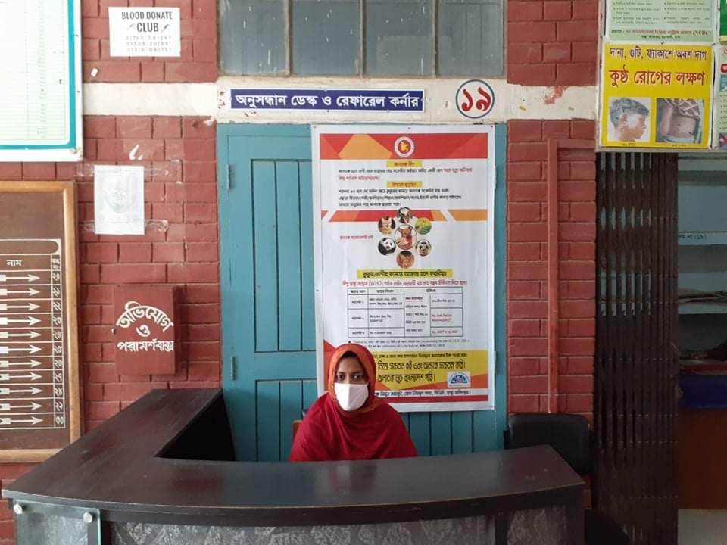
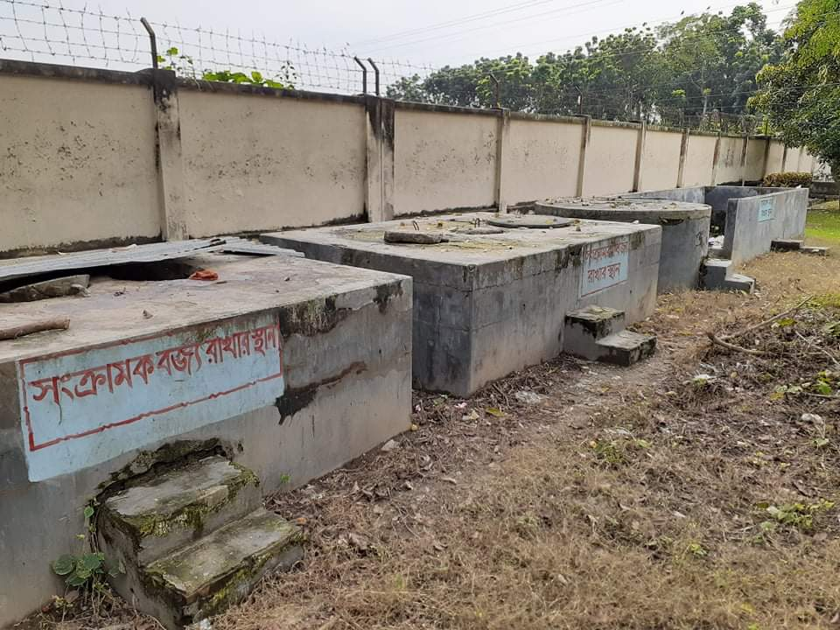
Beautification of the premises
Cycle stand near the entrance
Developed Waste Management System
Reception Desk

Slide 16


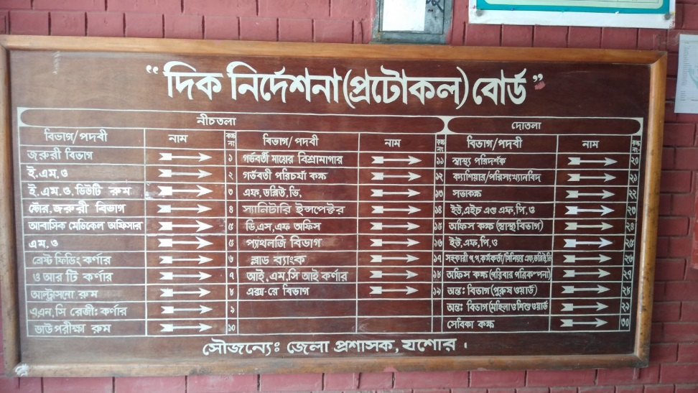
Citizen Charter
Protocol Board

Slide 17
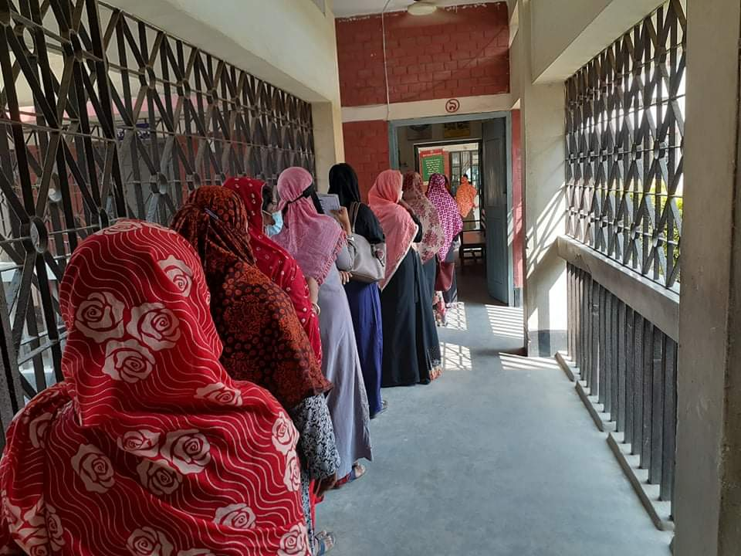



Separate line for the females
Developed ER with Sterile Workplace
Women Friendly Approach ( Privacy Maintenance )
Cell phone-based Health Service
Ultrasonography machine donated by the Upazila Porishod

Slide 18




IMCI corner
ANC Corner
Breast feeding, EPI & ORT Corner
NCD Activities

Slide 19

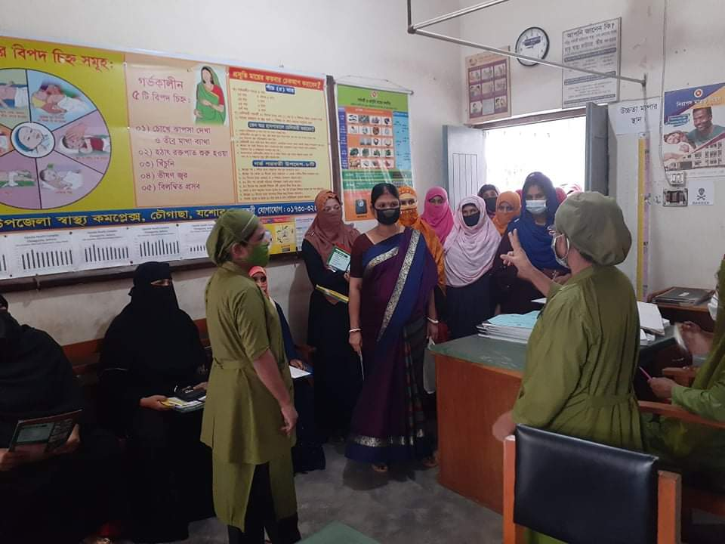
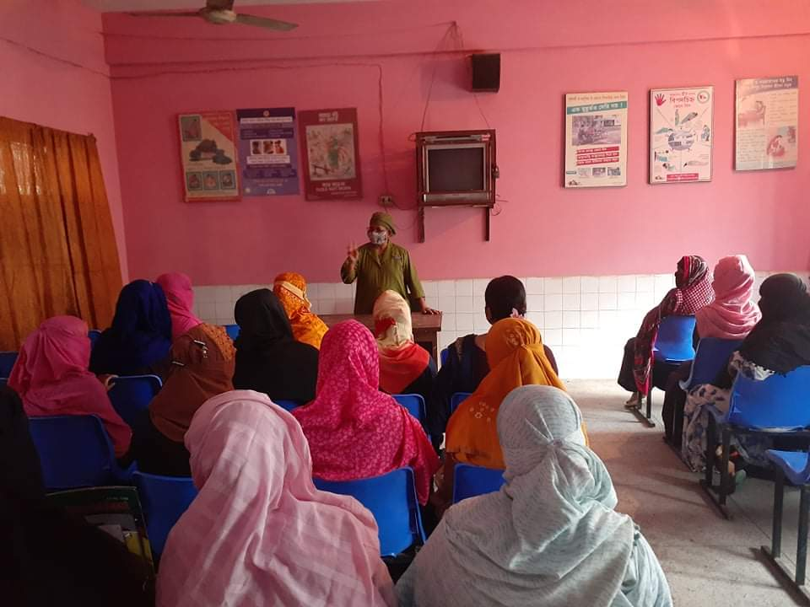
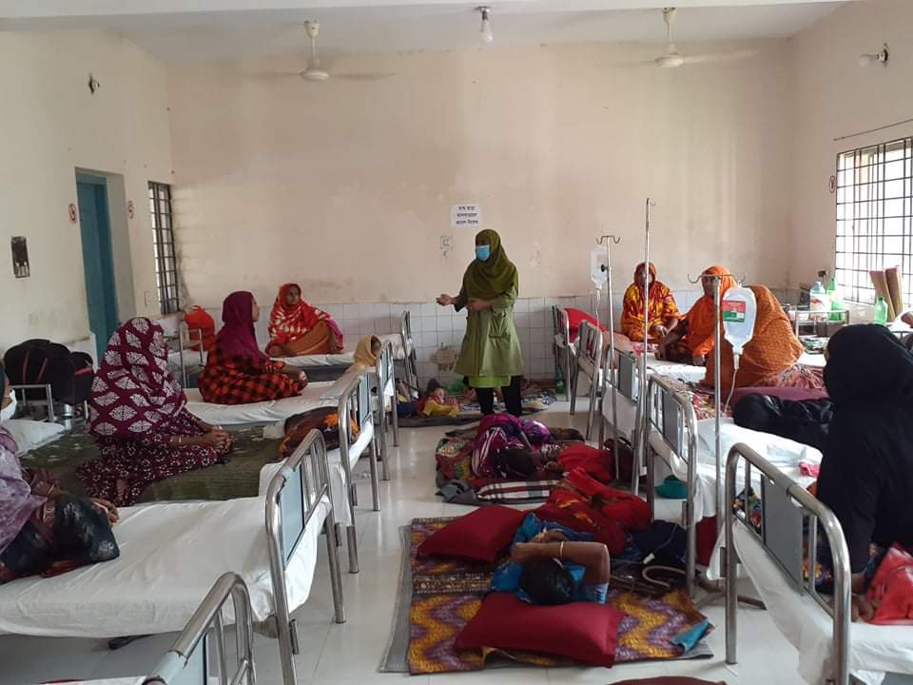
Daily Health Education Session
In ANC corner
In front of Emergency Room
In ANC Waiting room
Indoor

Slide 20



Rest Room for Pregnant Women
Separation of male and female patients in Indoor & Outdoor
Medical Dispensary

Slide 21
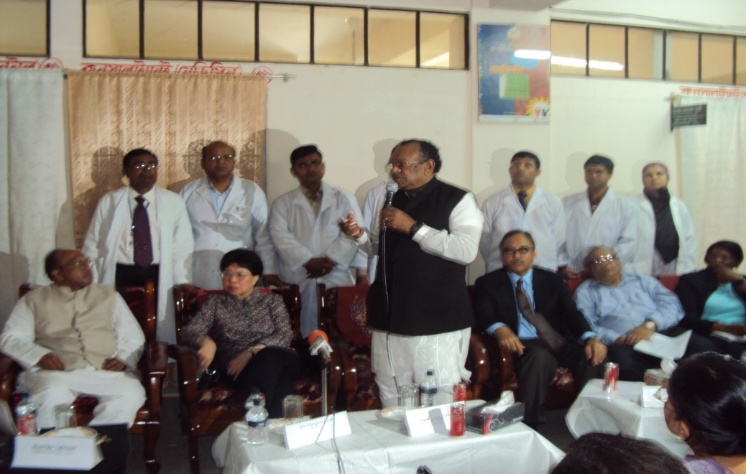

Visited UHC on 08 March-2010
Visited UHC on 20 June-2008
Honorable Health Minister, Honorable Health advisor & Honorable DG WHO
Dr. Margaret Chan
& other high officials of MOHFW & DGHS visited
Chowgacha health complex and praise the “Chowgacha UHC model”
Honorable Health Secretary A.K.M. Zaforullah Khan visited
Chowgacha health complex and Declared “Chowgacha UHC model” in
DSF voucher distribution ceremony.

Slide 22


Òevsjv‡`‡ki Rb¨ ewnt we‡k¦i
†Kvb g‡W‡ji cÖ‡qvRb †bB|
†PŠMvQv g‡WjB h‡_ó ,
†PŠMvQv ¯^v¯’¨ †mevq `w¶Y
c~e© Gwkqv‡Z GKwU `„óvšÍ ¯’vcb K‡i‡Q|Ó
†PŠMvQv g‡Wj nvmcvZvj cwi`k©bKv‡j
W. gvM©v‡iU P¨vb (gnvcwiPvjK, wek¦ ¯^v¯’¨ ms¯’v)

Slide 23
NVD in Chowgacha Health Complex

Slide 24
C-Section performed in Chowgacha Health Complex

Slide 25
Total number of NVD performed in different hospitals

Slide 26
Total number of C-Section performed in different hospitals

Slide 27

EOC Activities : 2010 - 2019(ANC First Visit)

Slide 28
EOC Activities : 2010- 2019(ANC Fourth Visit)

Slide 29
PNC Service 2010 - 2019

Slide 30
EOC Activities : 2010- 2019 (Hospital Delivery )

Slide 31
EOC Activities : 2010- 2019 (Caesarian Section)

Slide 32
UHC Chowgacha
IPD Services 2010-2019

Slide 33
Upazila Health Complex
CHOWGACHA , JESSORE.
EOC Activities : 2000 - 2011 (Caesarian Section)

Slide 34
Upazila Health Complex
CHOWGACHA , JESSORE.
EOC Activities : 2006 - 2011 (Caesarian Tubectomy)
167
2011
82
63
53
46
47

Slide 35
Upazila Health Complex
CHOWGACHA , JESSORE.
EOC Activities : 1997- 2011 (PNC )

Slide 36
Upazila Health Complex
CHOWGACHA , JESSORE.
Comparative Data of Delivery of best performing EOC center of Khulna Division in 2017
SL No | Name of institute | ANC | NVD | C. Section | Total
01 | Ad-din Hospital Jessore. | 23981 | 640 | 3075 | 3715
02 | Jhenaidah Sadar Hospital | 15360 | 1839 | 1143 | 2997
03 | 250 bed Hospital, Jessore | 13152 | 1327 | 1778 | 2967
04 | Chowgacha UHC | 18650 | 2163 | 759 | 2922
05 | Khulna Medical College Hospital | 6977 | 1455 | 1228 | 2683
06 | 250 Bedded Hospital, Kushtia | 4735 | 1595 | 919 | 2514

Slide 37
Bed Occupancy Rate (in percentage) of Chowgacha UHC

Slide 38
Emergency, OPD & IPD Data
Year | Emergency | OPD | IPD | Total
2011 | 6318 | 91638 | 14819 | 112775
2012 | 6672 | 80939 | 14112 | 101723
2013 | 8414 | 91541 | 13708 | 113663
2014 | 10866 | 94191 | 14349 | 119406
2015 | 11297 | 76159 | 14140 | 101596
2016 | 10832 | 123363 | 13933 | 148128
2017 | 14550 | 128319 | 15125 | 157994
2018 | 22620 | 113991 | 12836 | 149447
2019 | 28031 | 117561 | 16915 | 162508

Slide 39

COVID-19 Response of UHC Chowgacha
 | NUMBER | COMMENT
Total Specimen Collected | 971 | Until 1/11/2020
Total Detected Patient | 155 | Until 1/11/2020
Death | ০1 | Until 1/11/2020
Affected Healthcare workers | 27 | Until 1/11/2020

Slide 40
Achievements of Chowgacha Health Complex
In 2008, Chowgacha Health Complex declared as the model Upazilla health complex.
  EOC Beds increased from 11 to 41
  Chowgacha UHC achieved MDG target in 2009
  Chowgacha UHC became the best EOC center with 98.4% delivery rate in 2011.
  Chowgacha Health complex is awarded for best performance in EOC form 2005 to 2014.
  Achieve Health Minister s Award for its best performances in 2017 and 2018.
  The UHC starts upgrade to 100 bedded hospital.
  The UHC is being replicated throughout the country by MOH & FW and DGHS since 2016 by the order of prime ministers office.

Slide 41
History of Community Participation in Chowgacha
Doctors/Service providers initiate the community participation by arranged HR
Blood donation is another initiative
Hospital gate keeping by a volunteer
Ultrasonography machine donated by Upazila Porishod with the help of honorable MP
Local industrialist and elite persons are involved for community participation by using personal relationship
Local government involvement is done by showing the performance

Slide 42
Supports by JICA
In 1995 JICA helped us by supplying logistics and equipment in the Front Line MCH project
In 2012 JICA implemented the TQM project (5S Kaizen)

Slide 43
Special Supports of UNICEF in EmOC &
Women Friendly Hospital Initiative
EmOC and Newborn Equipment and Training of Doctors & Nurses on EmOC
Supply of furniture (chair and bench for sitting for patient / attendants), Water filter, curtain to maintain privacy
Supply of IPS, UPS, Laptop with multimedia for presentation of performance
Supply essential medicines, fund for fuel of Generator
Supply of Washing machine
Fund for salary of 4 senior staff nurses. 1 computer assistant, breast feeding assistant and Hospital Monitor
Allotment of fund for video program for Health Education

Slide 44
Challenges
Many of the Health Assistant Posts are vacant
Pediatric Consultant and other consultant posts vacant
Lack of pair of consultant gynaecologist and anesthetist residing at the hospital premises
Inadequate hospital store
Shortage of ward boy, ayah, other 4th class employees and field workers
No separate ward for diarrhea patients

Slide 45
Way Forward…
Digital Ticketing System and money counter
Online patient database
Separate dinning space for walk-in patients and attendants
Library for the doctors
Regular Academic Sessions for the Doctors and nurses
Day care center for mothers working in this hospital

Slide 46
Recommendations
Budget of health should be increased to support HR and logistics.
Community participation is one of the temporary solution of crisis period.
Arrangement should be done so that health complex run independently
Appointment of all staffs in the vacant post.
Consultants should be posted in vacant post.
Couple should reside in the station for round o clock EOC.

Slide 47
THANK YOU

